Slide 1
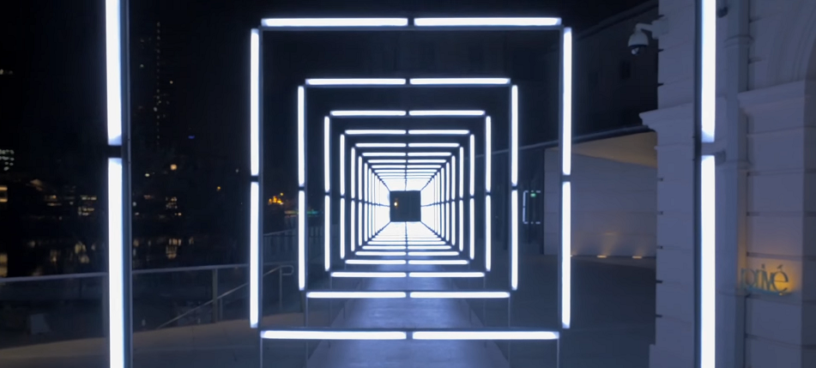
Interactive corridor
Robbe De Wispelaere
Aitor Vannevel
Simon Stijnen
NielsDenoo

Slide 2
The assignment
Creating atmosphere in the hallway
Use of lighting
Along the side of pillars
Control via website

Slide 3
Stakeholders
Students and teachers
Visitors to the school

Slide 4
limitations
Budget
Time
13 weeks
Knowledge

Slide 5
Succes Criteria
Interactive led strips
Controlled by website
Easy to expand

Slide 6
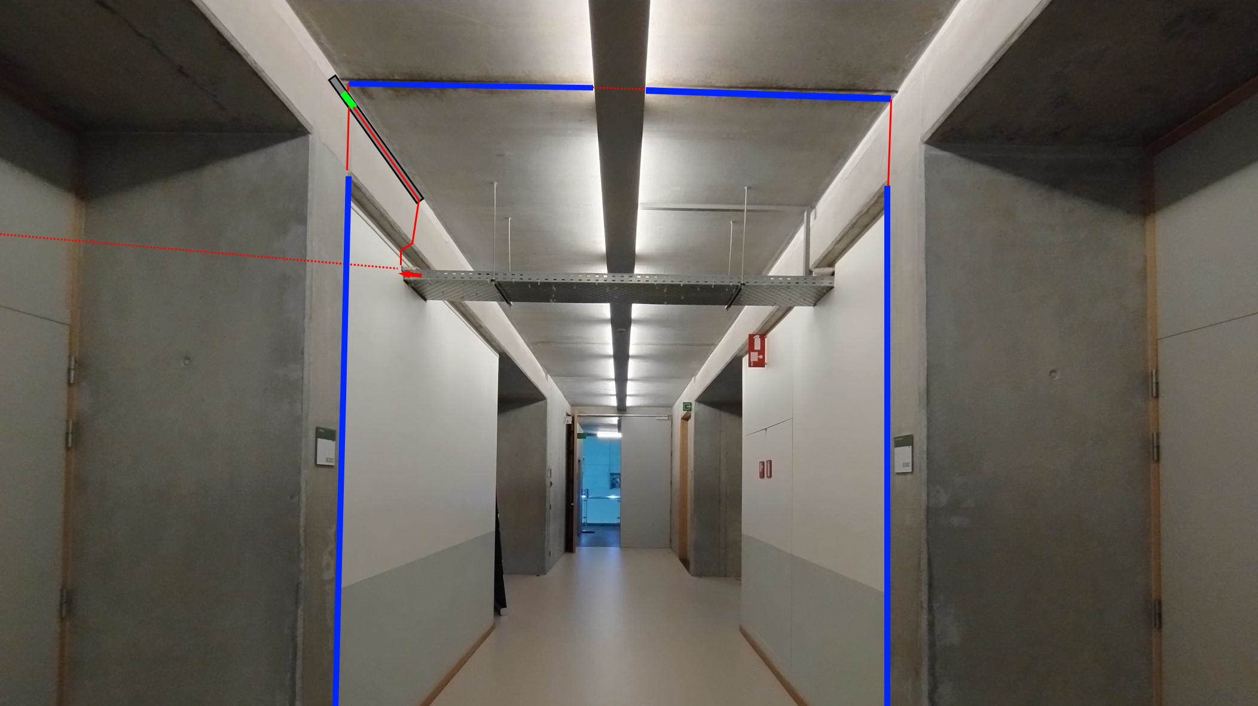

Slide 7
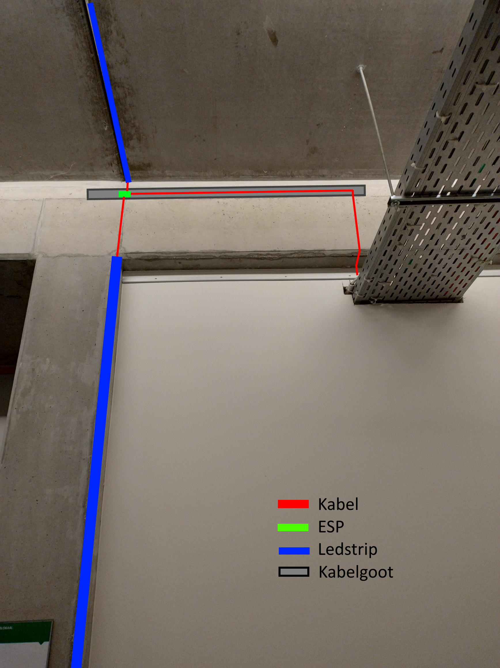

Slide 8
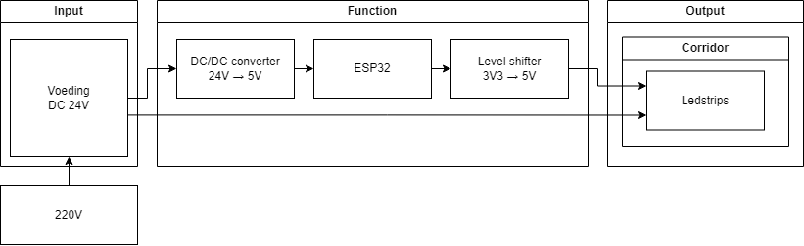
Hardware architecture diagram

Slide 9
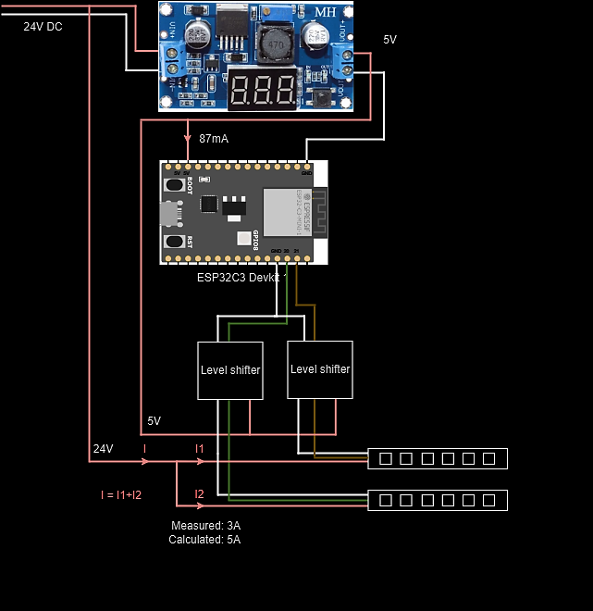
Wiring Diagram
Converter → ESP →Level shifter → Ledstrip

Slide 10
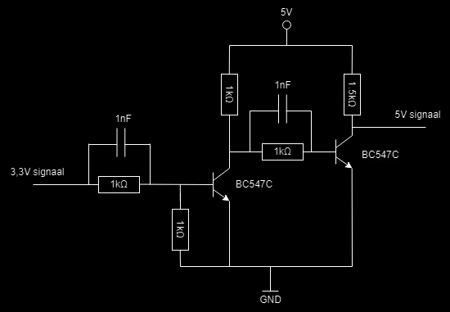
Level shifter

Slide 11
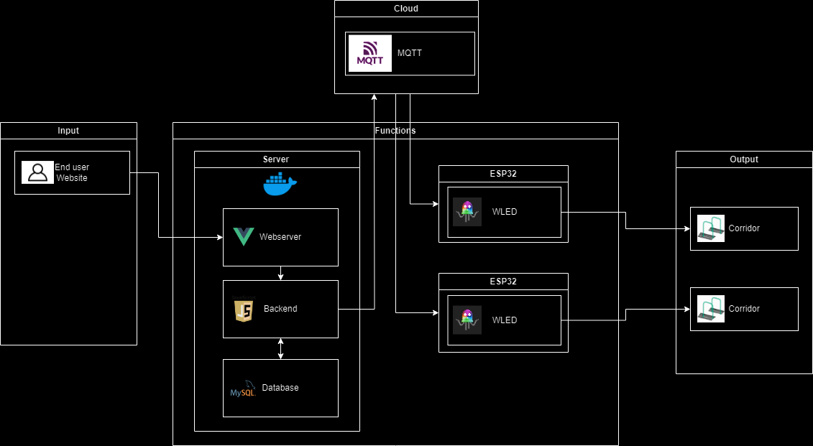
Software architecture diagram

Slide 12
The website

Slide 13
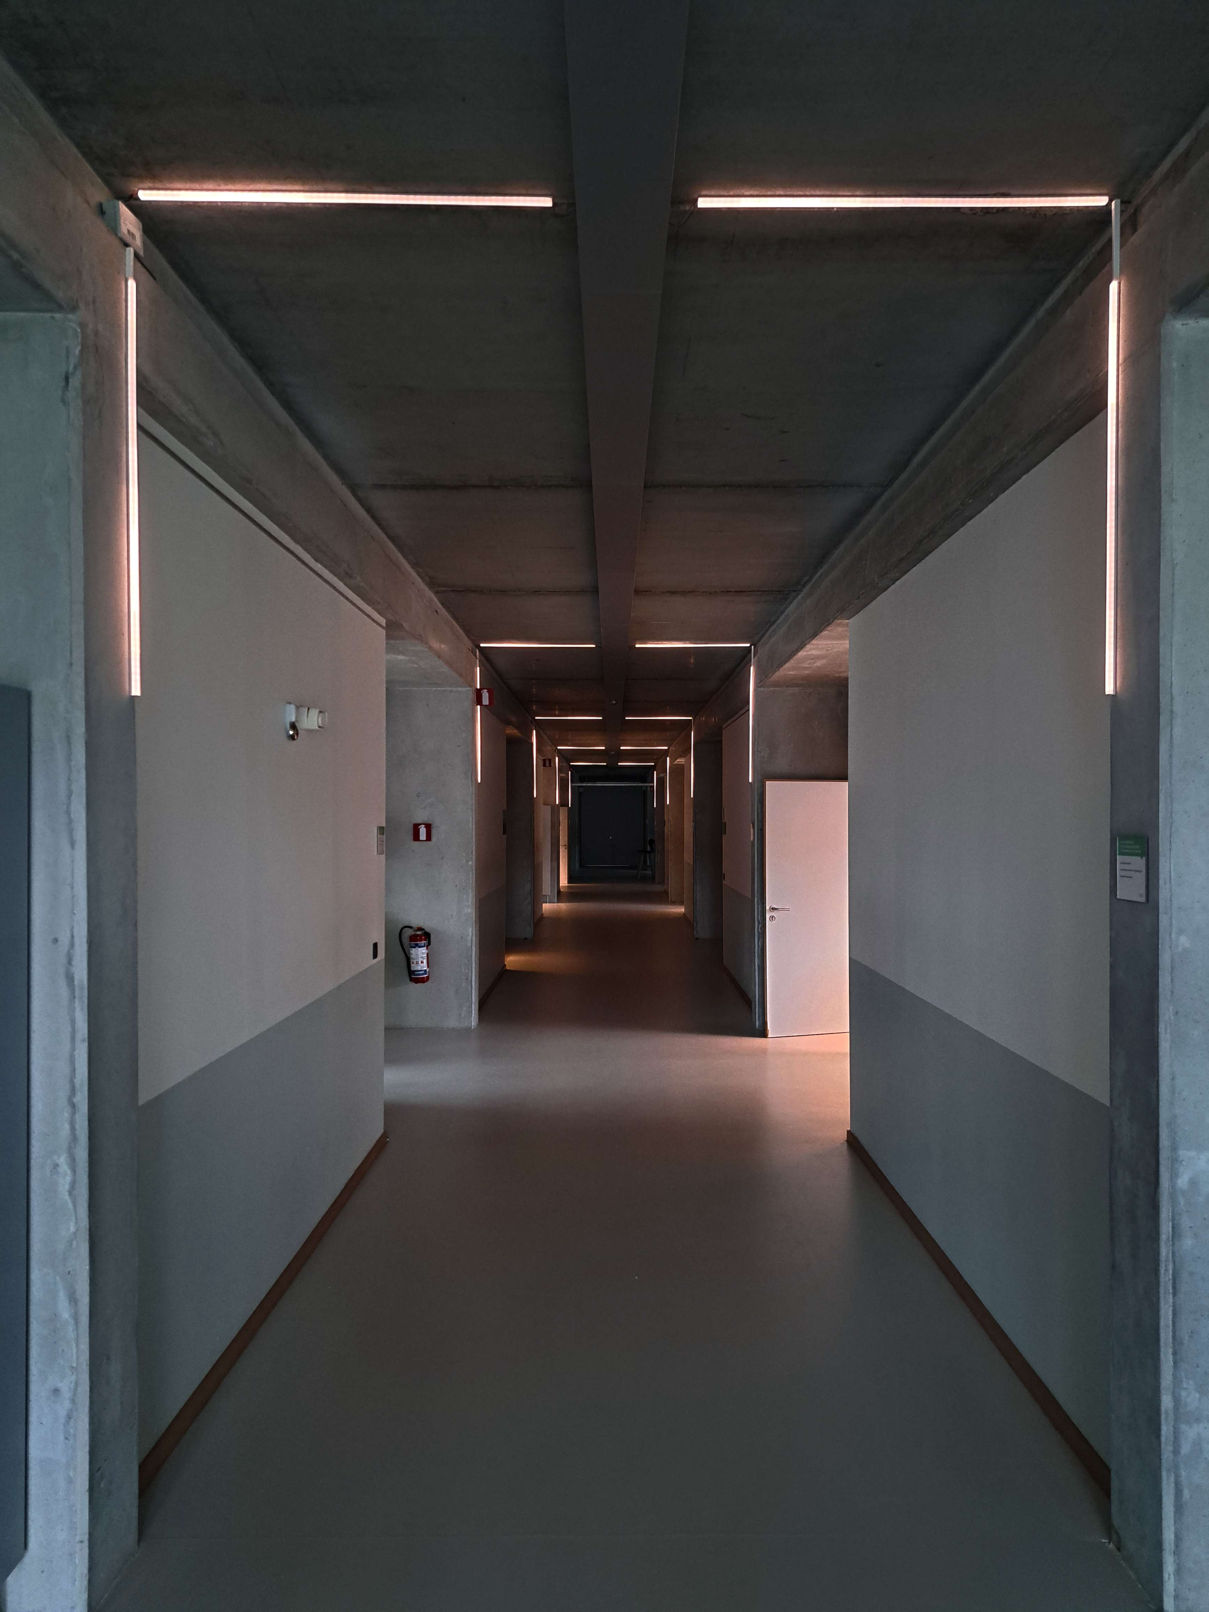
Problems
Buggs
Late deliveries
Going over budget

Slide 14
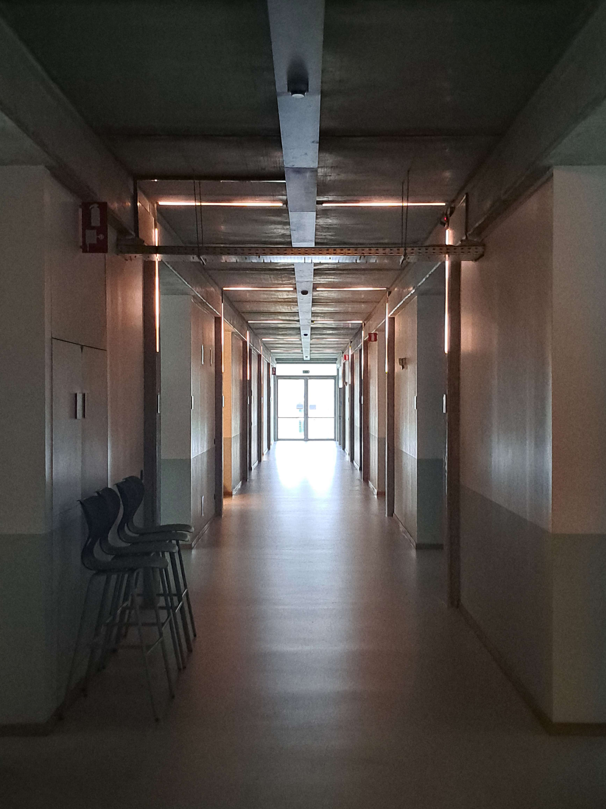
Solutions
Debuggen
Using your own material
Requesting larger budget

Slide 15
The team
Robbe De Wispelaere
Scrum master
Hardware
Aitor Vannevel
Backend
server
Simon Stijnen
Backend
Website
Niels Denoo
Documentatie
Hardware

Slide 16
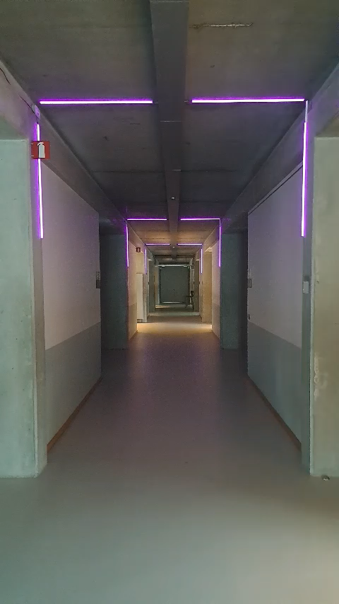
Demo

